Slide 1

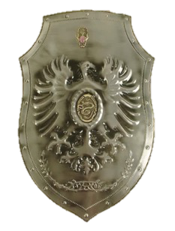
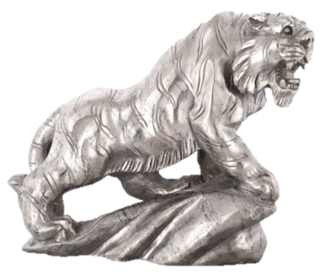
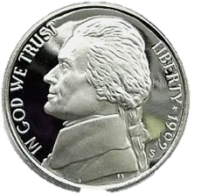
A Dictionary-based Approach for Estimating Shape and Spatially-Varying Reflectance
Zhuo Hui and Aswin C. Sankaranarayanan
Electrical and Computer Engineering
Carnegie Mellon University
Notes:
Thanks for coming, the talk is about non-lambertian photometric stereo.
Photometric problem is to estimate the shape of the objects given multiple images with varying lightings.

Slide 2

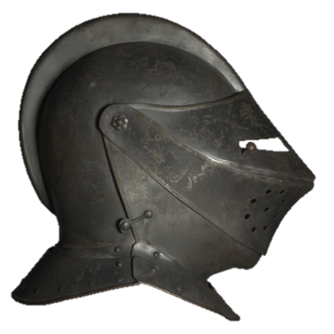
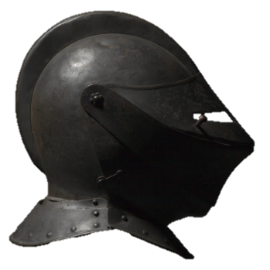
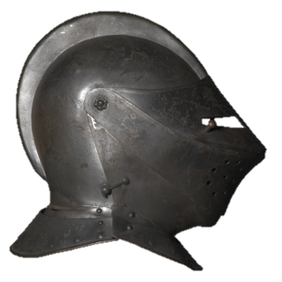
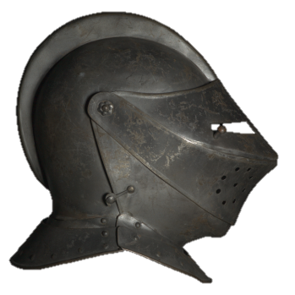
Problem setup
Collect multi images
Assumptions
Camera is orthographic and view direction is constant
Distant lighting with point light source
Knowledge of the light calibration
Target
Notes:
To begin with, let’s look at the photometric stereo problem setup.
We have static camera looking at the scene, and capturing multiple images of the scene as we varying the lightings.
We assume bunch of things to narrow the scope of the problem.

Slide 3










Image formation
$$l_{3}$$
$$I_{p}^{1}=$$
$$ρ_{p}^{}\left(n_{p},l_{1},v\right)$$
$$∙max(0,n_{p}^{T}l_{1})$$
$$l_{2}$$
$$n_{p}$$
$$l_{1}$$
$$I_{p}^{2}=ρ_{p}^{}\left(n_{p},l_{2},v\right)∙max(0,n_{p}^{T}l_{2})$$
normal
$$v$$
$$I_{p}^{3}=ρ_{p}^{}\left(n_{p},l_{3},v\right)∙max(0,n_{p}^{T}l_{3})$$
Incident direction
Viewing direction
P
Spatially varying BRDF
Shading term
Notes:
Next we can look at the image formation model under the problem setup.
Now let’s consider surface element p highlighted by the red box. Denote the surface normal associated with p as n and viewed direction as v.
And we take a light source from direction l, the image intensity observed are determined by two terms.
One is the SVBRDF, which characterizes the way how the material interact with the lights.
The second term is shading term, which encodes the orientation of the surface for the given lighting.
Now we move the light source, and we need to figure out the surface normals and spatially varying BRDF functions from these established equations.
The question here is whether this is a hard problem or something easy to solve.

Slide 4
Challenges
Notes:
However, this problem is extremely difficult to solve

Slide 5

Image formation
$$I_{p}= ρ_{p}\left(n_{p}^{}, l,v\right) ∙max(0, n_{p}^{T}l)$$
1. Surface normals and reflectance are coupled and need to be jointly estimated.
Notes:
The key challenge here is that (SV-BRDF) and surface normals are coupled and need to be jointly estimated.
It requires a sort of bilinear optimization to solve, which is non-convex and there are huge ambiguities in the solution space.

Slide 6




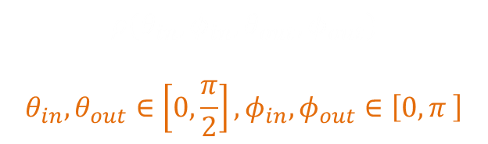

Image formation
$$I_{p}= ρ_{p}\left(n_{p}^{}, l,v\right) ∙max(0, n_{p}^{T}l)$$
2. Reflectance function is a very high-dimensional signal.
$$ρ(θ_{in},φ_{in},θ_{out},φ_{out})$$
$$θ_{in},θ_{out}∈\left[0,\frac{π}{2}\right],φ_{in},φ_{out}∈\left[0,π \right]$$
$$θ_{in}$$
$$θ_{out}$$
$$φ_{in}$$
$$φ_{out}$$
Notes:
The second problem, which is something very severe, we need to estimate the BRDF function for each pixel.
And BRDF is a very high-dimensional signal, as shown in this figure, it has two degree of freedom for the incident lights and two degree of freedom for the outgoing rays.
What we are trying to solve is by just looking at the intensity at the particular pixel and get the idea of this function.
If we do not have any additional knowledge, we need a lot of images to capture this function in all of its complexities.

Slide 7
Prior work
Notes:
So, it is instructive to look at how some of key prior works in this area have dealt with this problem.

Slide 8

Reference BRDF assumption
$$I_{p}= ρ_{p}\left(n_{p}^{}, l,v\right) ∙max(0, n_{p}^{T}l)$$
C₁
C₂
BRDF at each pixel is a weighted combination of a few reference BRDFs
Notes:
Here is a simple idea ---- instead of looking at each individually pixel, why do not we look at the collection of the pixels in the scene?
we can anticipate that most of the real world objects do not have too many unique materials.
On the whole, we can say that the number of the materials in a given scene is a small number.
Therefore, the BRDF at each pixel can be assumed as a linear combination of these so called reference BRDFs.
So, we do not need to estimate the entire BRDF at each pixel, we only need to estimate a few BRDFs and at each pixel estimating the coefficients relative to these reference BRDFs.
This is much more low dimensional signal that has to estimated for each single pixel.

Slide 9




Reference materials method
$$I_{p}= ρ_{p}\left(n_{p}^{}, l,v\right) ∙max(0, n_{p}^{T}∙l)$$
C₁
C₂
Parametric/Bivariate BRDF
Normals
BRDF
Fix
Optimize
Iterative
[Goldman et al. 2005]
[Alldrin et al. 2008]
Model Reference BRDF
Optimize
Fix
High computational cost
Requires a good initial guess
Notes:
Reference materials has been used in many different ways in previous work.
The basic formulations are as follows:
Given all the pixels in the scene, you only need to estimate a few reference BRDFs in the scene.
But for each individually pixel, you need to estimate the coefficients that are relative to the reference BRDFs and the surface normals.
You can expect that this is a multi-linear optimization problem, typically involving three independent variables.
And we need a lot of computational power to iterate between surface normals, reference BRDFs and relative coefficients.
And only works well when you have good initialization, which is severe drawbacks when you do the photometric stereo in the wild.

Slide 10
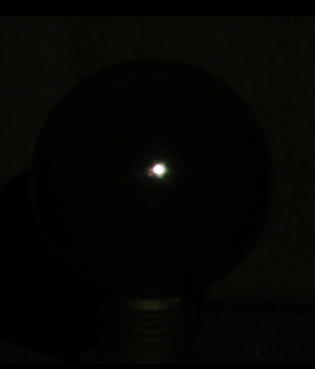
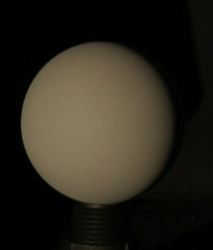
Example based method
[Hertzman and Seitz, 2005]
Placing objects into the scene is not desirable
BRDF estimation is always poor
Notes:
It does the following things
Now there are something called orientation consistency comes to play.
The idea is that two surface element with identical surface normals and BRDFs will appear nearly the same under the varying lightings.
On top of that, all we need to do is to scan over the set of candidate normals and find the one closely matched to the target.
But in return, you need to tamper the scene by placing the objects.
Moreover, limited by the number of reference objects,
if the target object has very complex BRDF, there are no guarantee that BRDF at the pixel going to be the linear combination of the BRDF on the reference objects.

Slide 11
Virtual Reference Objects
Notes:
Now we ask the following question, would it be wonderful if we have hundreds of reference objects such that it does not matter how complicate the target BRDFs are?
It always lie in the span of reference BRDFs.
Doing this by introducing the reference objects into the scene is extreme hard.
But what we can do is to create virtually reference objects.
And I am going to describe how this can be done.

Slide 12














































Proposed technique
Known illumination
Reference object
(Specular)
Target
Target
Reference object
(Lambertian)
BRDF Dictionary
Notes:
The idea is as follows:
Instead of inserting physical reference objects, we use a dictionary of BRDFs associated with common materials to create a virtual gallery of reference objects.
The advantage of this is there are no more restrictions in the number of reference objects we need to have.
We can use as many as BRDFs we have.

Slide 13









Image formation model
$$I_{p}^{1}=ρ_{p}^{}\left(n, l_{1},v\right)∙max(0,n_{p}^{T}l_{1})$$
$$I_{p}^{2}=ρ_{p}^{}\left(n,l_{2},v\right)∙max(0, n^{T}l_{2})$$
$$I_{p}^{3}=ρ_{p}^{}\left(n, l_{3},v\right)∙max(0, n^{T}l_{3})$$
$${s(l_{1},v;n)}^{T}ρ_{p}$$
$$\tilde{ρ}= \left[\begin{matrix}ρ_{p}^{}\left(n, l_{1},v\right) \\ ρ_{p}^{}\left(n, l_{2},v\right) \\ ρ_{p}^{}\left(n, l_{3},v\right)\end{matrix}\right]$$
$${s(l_{2},v;n)}^{T}ρ_{p}$$
$$\tilde{ρ}={s\left(l,v;n\right)}^{T}ρ_{p}$$
$${s(l_{3},v;n)}^{T}ρ_{p}$$
$$ρ_{p}$$
Notes:
Now let’s look at how it works.
This is image formation model.
If we look closely at the BRDF term, it can further split into two terms.
One is the BRDF vector rho_p,
and the other is a selection vector s which samples the appropriate entry from the BRDF based on surface normal, view direction, and lighting direction.

Slide 14




Image model
$$I_{p}= \left[\begin{matrix}I_{p}^{1} \\ I_{p}^{2} \\ I_{p}^{3}\end{matrix}\right]=\left[\begin{matrix} max(0, n_{p}^{T}l_{1}){∙s}_{\{l_{1},v; n_{p}\}}^{T} \\ max(0,n_{p}^{T}l_{2}){∙s}_{\{l_{2},v;n_{p}\}}^{T} \\ max(0,n_{p}^{T}l_{3}){∙s}_{\{l_{3},v;n_{p}\}}^{T}\end{matrix}\right]ρ_{p}$$
=$A(n_{p})∙ρ_{p}$
$$ρ_{p}=D∙c_{p}$$
1. The coefficients are non-negative
2. BRDF relies on a few atoms
$$\left\{{\hat{n}}_{p},{\hat{c}}_{p}\right\}=\underset{n, c}{argmin}{\left\|I_{p}−A(n)∙D∙c\right\|}_{2}^{2}+λ{\left\|c\right\|}_{1}$$
s.t. $c≥0$
${\left\|n\right\|}_{2}^{}=1$
Notes:
Now if you look at the overall image formation equation, you can obtain something very neatly into product of two terms.
The first term includes both the shading term and selection vector and depends on the surface normals, we call it A of n.
And the second term is nothing but the vectorized BRDF, which is a very high dimensional signal.
Next we need to introduce the dictionary of BRDF into the model. We denote the BRDF dictionary as D and each of column of it represents a material BRDF.
A simple solution is to model the BRDF as the product of the BRDF dictionary with a coefficents c.
But we need to restrict this by introducing the following constraints.
The first constraint primarily helps to retain the BRDF at each pixel to be nonnegative.
In addition, the second constraint serves to avoid overfitting to the observed intensities.
Note that, by utilizing the dictionary, the key advantage provides here is that we do not need to estimate the high dimensional vector rho, instead, we only need to estimate the coefficient c whose dimension is very small.
At each pixel, we solve the optimization problem as follows:

Slide 15
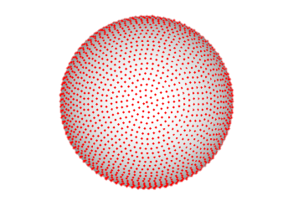

Problem formulation
$$\left\{{\hat{n}}_{p},{\hat{c}}_{p}\right\}=\underset{n, c}{argmin}{\left\|I_{p}−A(n)∙D∙c\right\|}_{2}^{2}+λ{\left\|c\right\|}_{1}$$
s.t. $c≥0$
${\left\|n\right\|}_{2}^{}=1$
Problem is non-convex
But
Given surface normal n, we can easily solve for the relative coefficient of the material “c”
Notes:
Now the question is how do we solve for it.
The optimization problem is hard due to the term A of n and the unit norm constrain on surface normal.
But here is an interesting idea
If we have a set of candidate normals with unit norm, and we know the target surface normal can be covered by this set,
then we continue enumerating the candidate normals in the set and find the coefficients c via solving a convex problem.
And we pick up the candidate normal with least error in the data term as the true surface normal.
The idea relies on the simple fact the set of normals belongs to the 2D sphere in 3 dimensional space.
So we can sample it at high resolution to obtain the surface normal estimates as accurate as the sampling resolution on the sphere.
Moreover, by requiring the candidate normal being unit, the unit norm constraint can be absorbed.
Then, by introducing a set of candidate normals, both the term A of n and unit norm constraint can be dealt with.

Slide 16


Normal estimation
$$\left\{{\hat{n}}_{p},{\hat{c}}_{p}\right\}=\underset{n, c}{argmin}{\left\|I_{p}−A(n)∙D∙c\right\|}_{2}^{2}+λ{\left\|c\right\|}_{1}$$
$$\text{s}\text{.}\text{t}\text{. }c≥0$$
$$\left\{{\hat{n}}_{p},{\hat{c}}_{p}\right\}=\underset{n∈N, c}{argmin}{\left\|I_{p}−A(n)∙D∙c\right\|}_{2}^{2}$$
s.t. $c≥0$
Time-complexity !
Notes:
Now, we would like to search for the normal estimate based on the candidate normal set, and we drop the sparsity constraint for computational efficiency.
We empirically observed that dropping the sparsity constraint made little difference in the estimated surface normals.
But what are the problems of this approach?
As we can expected since the surface normal estimates depends on the resolution on the sphere, if we require very precise normal estimates, it leads to huge candidate normals set.
Therefore the computational cost can be overwhelming which is not desirable.

Slide 17
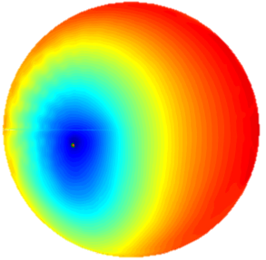
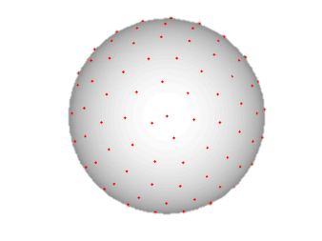
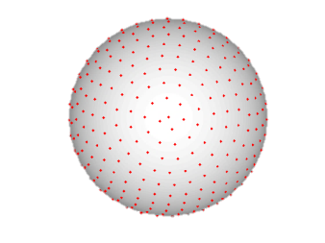

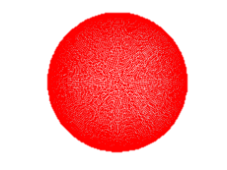

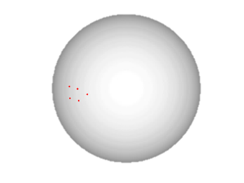
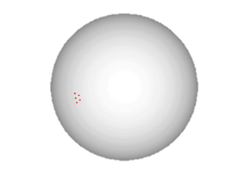
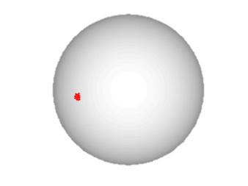
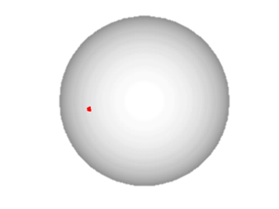

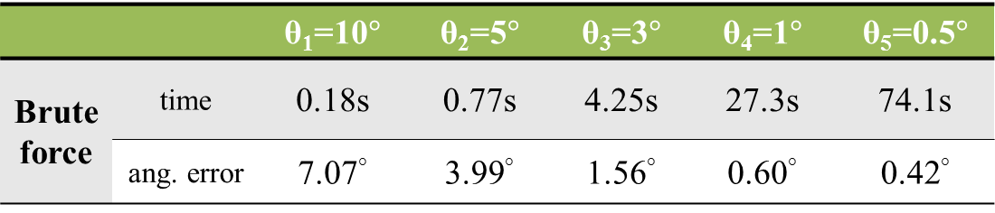
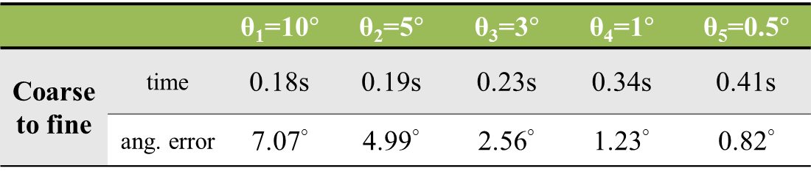
Multi-scale search
$$E=\min_{c≥0}{\left\|I_{p}−A(\tilde{n})∙D ∙c\right\|}_{2}^{2}$$
Error distribution
75
250
1500
10000
20000
 |  | θ₁=10$°$ | θ₂=5$°$ | θ₃=3$°$ | θ₄=1$°$ | θ₅=0.5$°$
Brute force | time | 0.18s | 0.77s | 4.25s | 27.3s | 74.1s
 | ang. error | 7.07° | 3.99° | 1.56° | 0.60° | 0.42°
75
5
5
14
8
 |  | θ₁=10$°$ | θ₂=5$°$ | θ₃=3$°$ | θ₄=1$°$ | θ₅=0.5$°$
Coarse to fine | time | 0.18s | 0.19s | 0.23s | 0.34s | 0.41s
 | ang. error | 7.07° | 4.99° | 2.56° | 1.23° | 0.82°
Notes:
Initially, we generate the candidate normals in different sampling scale based on minimum angular spacing between candidate normals.
We note that the smaller the angular spacing the larger the candidate normal set.
If we utilize the brute force search, the run time is linear in the number of candidate normals.
In contrast, we first evaluate the cost metric at a coarse sampling, and subsequently search in the vicinity of this solution but move to a finer sampling level.
We continue doing this until the we reach the finest sampling level.
As a consequence, the proposed techqniue only requires a tiny fracton of the time but can nearly achieve the same precision.

Slide 18


BRDF estimation
$${\hat{c}}_{p}=\underset{c≥0}{argmin}{{\left\|I_{p}−A({\hat{n}}_{p})∙D∙c\right\|}_{2}^{2}+λ{\left\|c\right\|}_{1}}$$
$$ρ_{p}=D∙{\hat{c}}_{p}$$
Estimated BRDF
Per-pixel BRDF
Notes:
Now we have the normal estimate, we can estimate the per-pixel BRDF by solving the whole optimization problem.
Now, we add the sparsity constraint back simply because to avoid overfitting and promote sparse solutions.
Then we can multiply the coefficients to the BRDF dictionary to get the final estimates.
At this stage, we have the pre-pixel surface normal and BRDF estimates.
The ability to get per-pixel BRDF estimates is unprecedented, and is only possible by using BRDF dictionary.
And this is something the hallmark of our approach.

Slide 19
Evaluation on synthetic data
Notes:
To evaluate our method, we characterize the performance of our technique using both synthetic and real datasets.
Now let’s look at the synthetic results first.

Slide 20
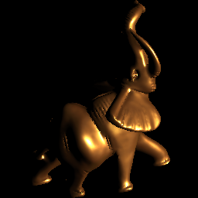
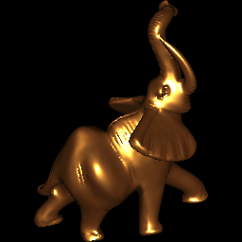
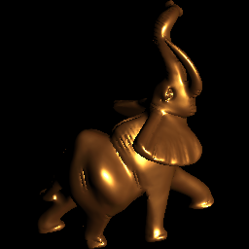
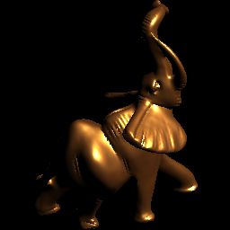
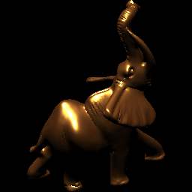
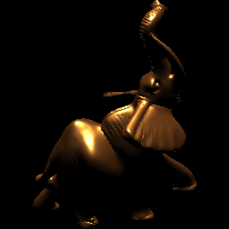
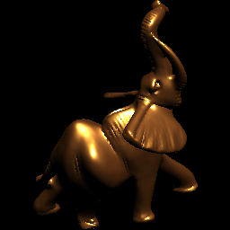
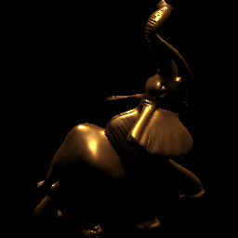
Normal estimation comparison
Input images
Notes:
Here is the object which is non-lambertian.
And I am showing the 8 images out of 253 input images used.

Slide 21

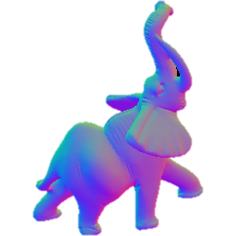
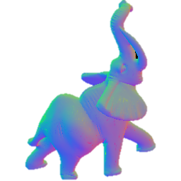


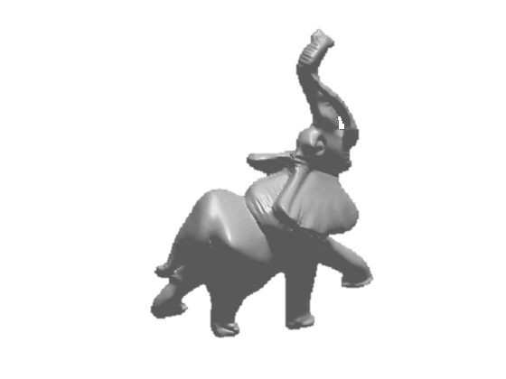
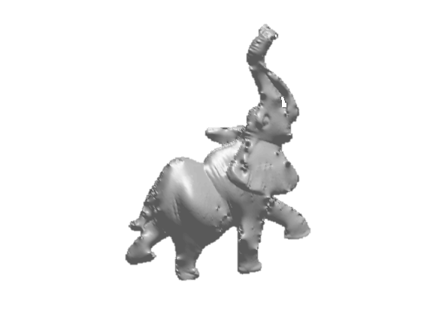
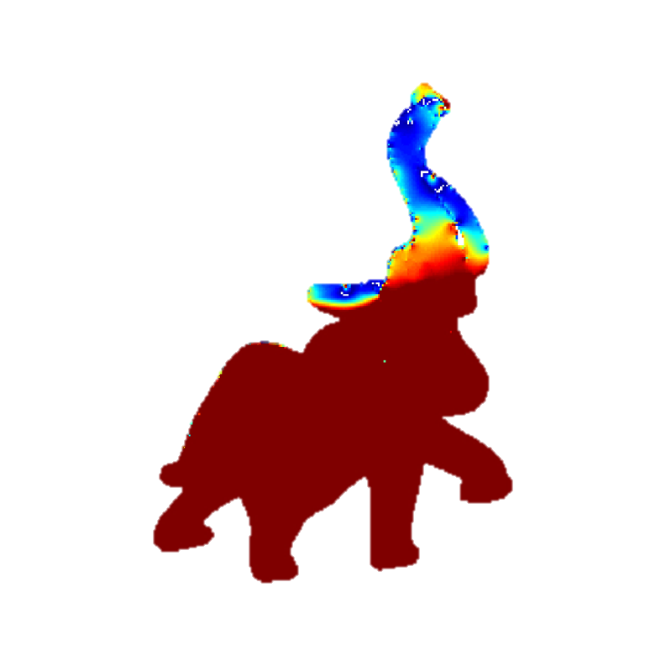

Comparison: Lambertian Photometric Stereo
Ground truth
Lambertian PS
11.5 ◦
Normal Map
Angular error
21.2mm
Relative Error
Surface
Notes:
Now I am showing the normal estimation and surface reconstruction results for the ground truth as well the approach wants to compare.
And I am also showing the angular error in degree for normal estimate and relative error in surface reconstruction.
First, we compare the results to photometric stereo under Lambertian model.
As we can see, the lambertain model PS fails since the synthetic object is extremely non-lambertian.
As a consequence, the lambertain PS gives a larger than 10 degree on the average of the normal estimation.

Slide 22

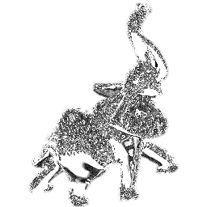
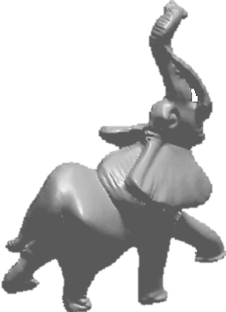
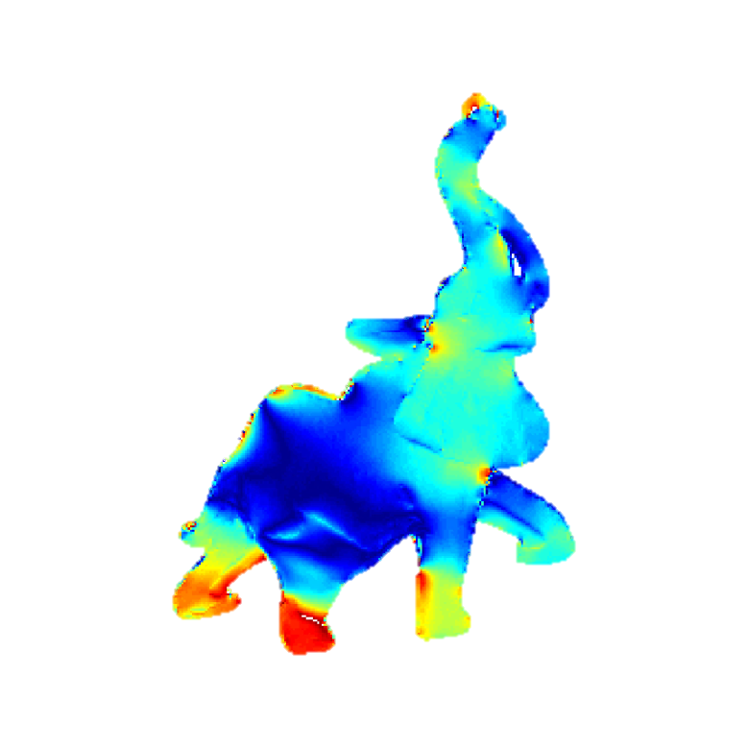
Comparison: Reference based method
Ground truth
Alldrin et al. 2008
3.29 ◦
Normal Map
Angular error
1.83mm
Relative Error
Surface
N. Alldrin, T. Zickler, and D. Kriegman. Photometric stereo with non-parametric and spatially-varying reflectance. In CVPR, 2008
Notes:
The results of Alldrin et al are much better than Lambertian based PS.
This is because they handled non-lambertian components of the objects.
But the underlying problem of their method is non-convex and riddled with locally minima, the results depend on the initial guess.
As a consequence, the method still produces normal estimation errors greater than 3 degree.

Slide 23

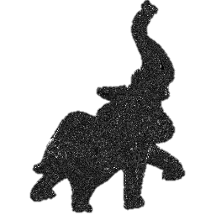

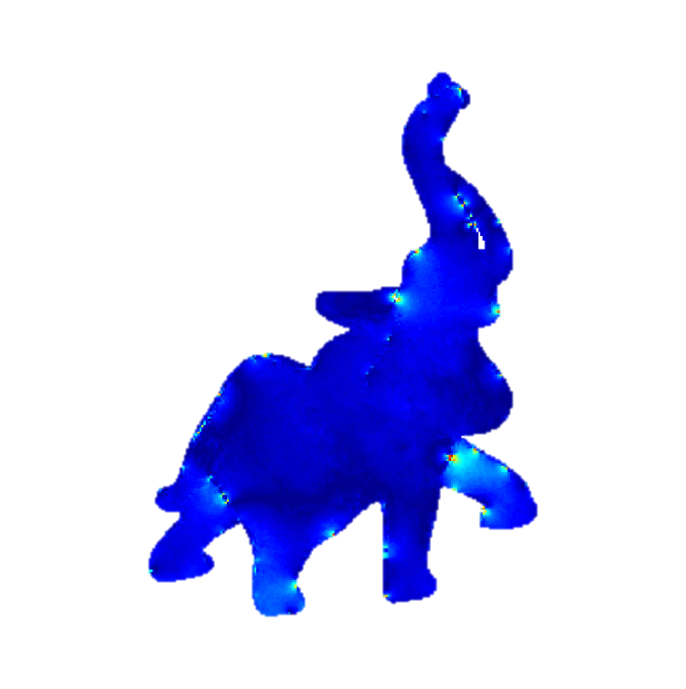
Comparison: the proposed method
Ground truth
Proposed
0.61 ◦
Normal Map
Angular error
0.27mm
Relative Error
Surface
Notes:
In contrast, the proposed method returns most accuracy normal estimates.
This can be attributed to the proposed method get the normal estimate via solving a well posed problem.

Slide 24
Evaluation on Real data

Slide 25
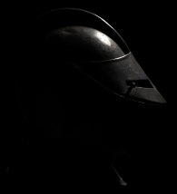
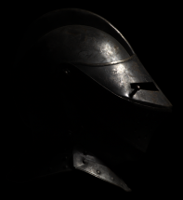
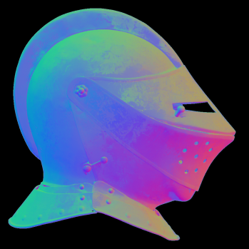
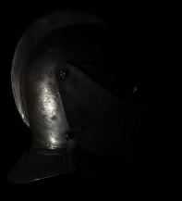
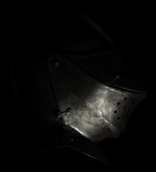

Shape Estimation
Estimated surface normals
Input images
Color code for normals
Notes:
The helmet in this scene has little diffuse component. Our proposed method can well recovers fine details on the object.

Slide 26
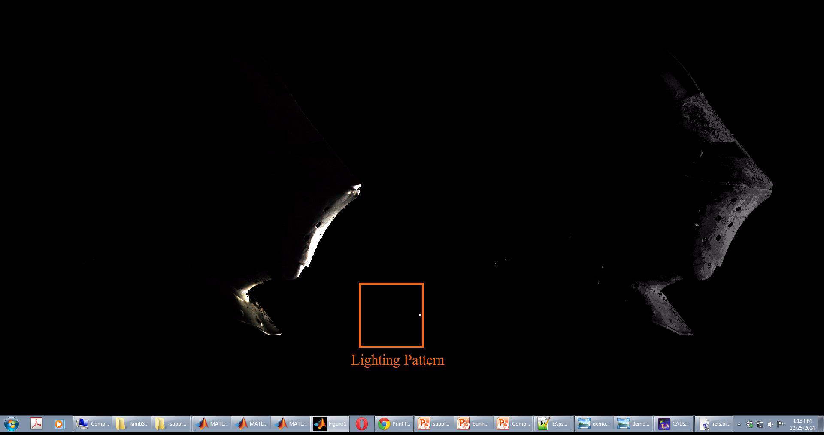
Helmet
Rendered
Lambertian Shaded
Notes:
Here is a sequence of video showing the rendering results under the novel lighting conditions based on the estimated per-pixel surface normal and BRDFs.

Slide 27
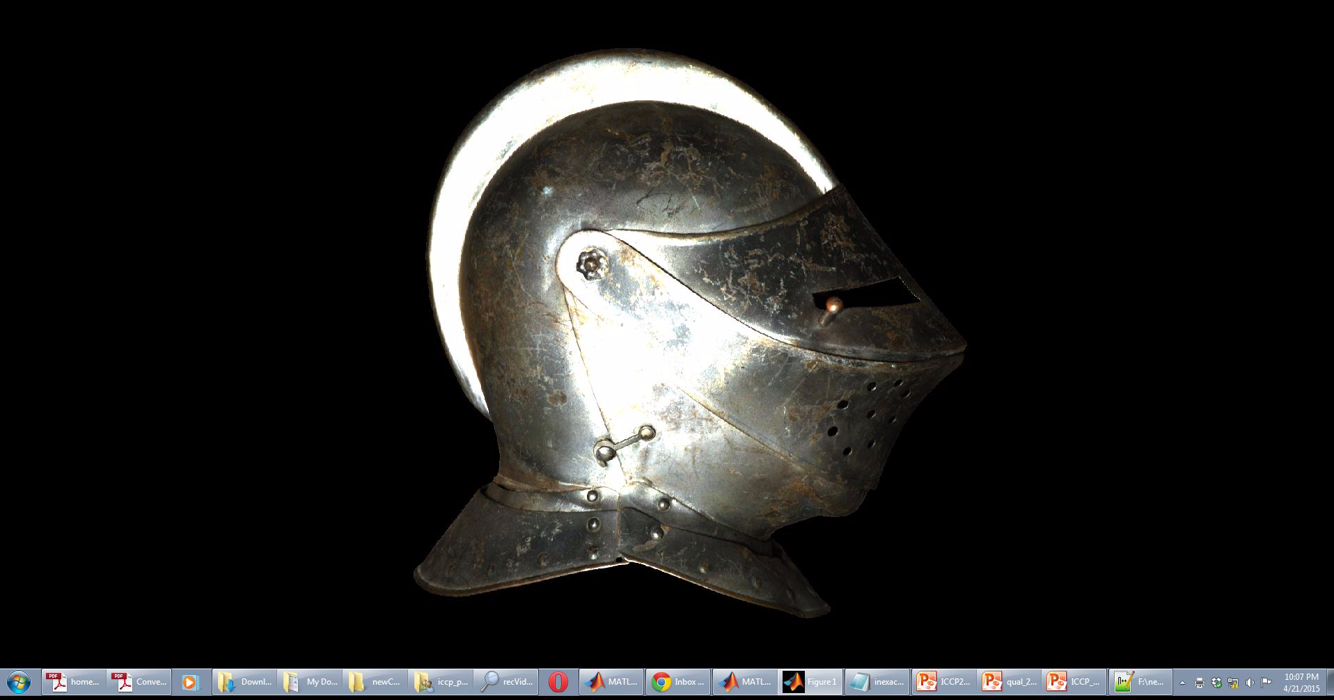
Helmet
Notes:
Here is a another video showing the rendering results for the novel view directions for the estimated the per-pixel surface normal and BRDF
In all of this, our goal is to show that our per-pixel framework is not only robust not also can render physically faithful results.

Slide 28
Summary
Photometric stereo with a dictionary of BRDF
Well-posed normal and BRDF estimation
Per-pixel normal and BRDF estimation
Notes:
In summary, what we have is traditional photometric stereo approach but applies to non-lambertian object.
The key assumption we make is that BRDF at each pixel lies in the non-negative span of some known BRDF dictionary.
In return, the ability we have enabled is that we can now for the first time get the per-pixel normal and BRDF estimate with a tractable framework.

Slide 29
References
Aaron Hertzman and Steve M. Seitz, “Example-Based Photometric Stereo: Shape Reconstruction with General, Varying BRDF”, PAMI 2005
Dan B Goldman, Brian Curless, Aaron Hertzmann, Steven M. Seitz, “Shape and Spatially-Varying BRDFs From Photometric Stereo”, ICCV 2005
Neil Alldrin, Todd Zickler, and David Kriegman, "Photometric Stereo With Non-Parametric and Spatially-Varying Reflectance“, CVPR 2008
Boxin Shi, Ping Tan, Yasu Matsushita, and Katsushi Ikeuchi. “Elevation angle from reflectance monotonicity: Photometric stereo for general isotropic reflectantes”. ECCV 2012

Slide 30
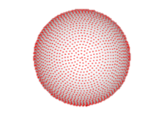
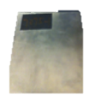

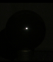
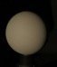





Problem formulation
$$\left\{{\hat{n}}_{p},{\hat{c}}_{p}\right\}=\underset{n, c}{argmin}{\left\|I_{p}−A(n)∙D∙c\right\|}_{2}^{2}+λ{\left\|c\right\|}_{1}$$
$$\text{s}\text{.}\text{t}\text{. }c≥0$$
$$B\left(n\right)=A(n)∙D$$
$$b_{ij}(n)$$
Materials
Known illumination
$${\hat{n}}_{p}=\underset{\tilde{n}∈N}{argmin} \min_{c_{1},c_{2}>0}{\left\|I_{p}−c_{1}I_{S}\left(\tilde{n}\right)−c_{2}I_{D}\left(\tilde{n}\right)\right\|}_{2}^{2}$$
$$B(n)$$
Notes:
Now let’s look closely at the entries of the product of term A of n and BRDF dictionary D, and we introduce the matrix B of n to represent it.
We denote the bij as the entry for B of n, which indicates the observed intensities for the candidate normal n under ith lighting directions associated with jth material in the BRDF dictionary.
Having a close comparison with example based method, we can find that B of n denotes the observed intensities on the a set of reference objects that we do not insert into the scene.
In this way, we introduce a set of virtual reference objects based on a dictionary of BRDFs.

Slide 31







Virtual reference sphere
$$D= \left[{ ρ}_{1, }{ ρ}_{2, }{ ρ}_{3, }…{ ρ}_{M−1 ,}{ ρ}_{M }\right]$$
Notes:
Next, we would like to talk about how to generate matrix B which is the key factor in the optimization.
For each candidate surface normal with unit norm, and each material in the dictionary, we create a matrix B of observed intensities as the lighting in the scene is varied. Therefore, B is the collection of virtual objects with different materials under the given lighting conditions.

Slide 32




Comparison: example based method
Ground truth
Example-based
1.84 ◦
1.67
Notes:
We also simulated the performance of example-based photometric stereo which is identical to the proposed technique but applied to a two material (white-diffuse and chrome) dictionary

Slide 33
Example based VS the proposed method
Example-based
Proposed
1.84 ◦
0.61 ◦
1.67
0.27
Notes:
As expected, having a larger dictionary of BRDFs as in the proposed technique does provide significant improvements in surface normal estimation.

Slide 34






Normal estimation for varying number of lights
Lights Distribution
Shi et al. 2010
B. Shi, P. Tan, Y. Matsushita, and K. Ikeuchi. Elevation angle from reflectance monotonicity: Photometric stereo for general isotropic reflectances. In ECCV. 2012.
Notes:
Now I am showing you the errors in surface normal and BRDF estimation for varying number of lighting directions, which are shown as blue dots on the sphere.
The curves shown are computed by randomly generating normals per material and varying across all the material in the database.
This experiment is similar in setup to the one reported in shi et al, which, to our knowledge, is one of the most accurate photometric stereo techniques on isotropic BRDFs.
Compared with the method in Shi et al., for 200 images, the error in estimating the elevation angle is reported as 0.88 degree;
In contrast, the proposed technique has an error of 0:82 degree in estimating the surface normal without any prior knowledge of the azimuth.
Therefore, we do a much better job than Shi and others.

Slide 35



Helmet

Slide 36
Limitations
Requires the knowledge of light calibration
Normal estimates are bounded by the sampling
Per-pixel framework may produce noise estimates
Notes:
But there are some limitations of the proposed work that we need to work on in the future.

